Slide 1


Peloton x Disney Marketing Plan
TEAM 2:
Brody Serafin
Rekha Dunn
Anshul Hallur
Natali Duenez
Derick Truong

Slide 2
TABLE OF CONTENTS
01
02
03
INTRODUCTION
CAMPAIGN
CONCLUSION

Slide 3
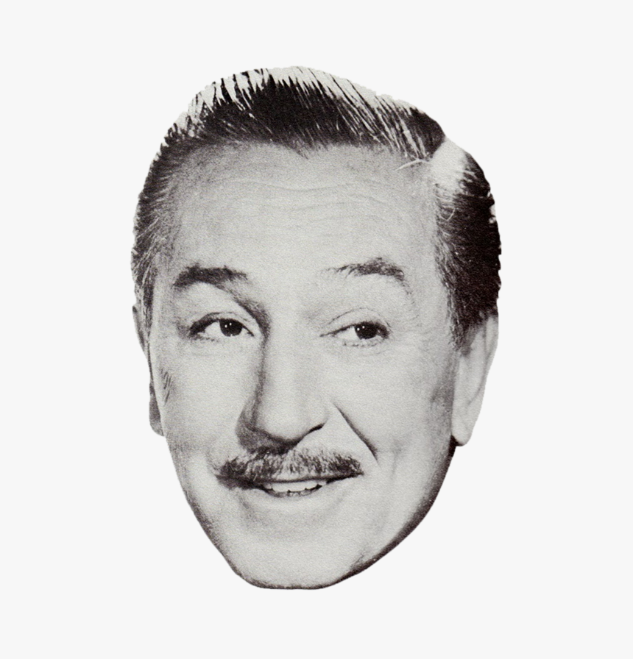
—Walt Disney
“Ideas come from curiosity.”

Slide 4
01
INTRODUCTION

Slide 5
INTRODUCTION
Founded in 2012 by John Foley
Promise of innovation and inspiration
Mission Statement of Peloton
Marketing Objectives and Goals
Disney x Peloton

Slide 6
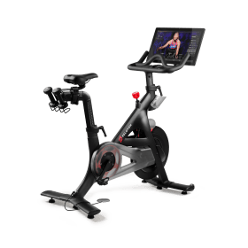

PRODUCT
PRICE
FEATURES
$1,445
-Access hours of classes from the tablet
-Work out alongside other members & friends
-Plan & customize workouts.
-Track progress
OVERVIEW
-Immersive 22” HD touchscreen
-In-workout metrics like heart rate, output, cadence, & resistance

Slide 7

Target Market/ Consumer Behavior
Primary: Millennials
Ages between (27-41)
Secondary: Disney fans
Tertiary: General fitness population

Slide 8
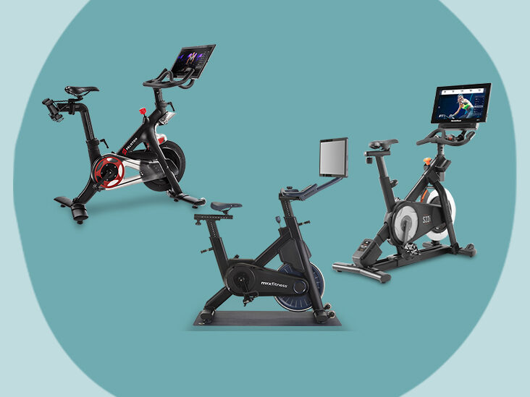
COMPETITORS
Peloton’s competitors include: NordicTrack, SoulCycle, Bowflex, Echelon, Life Fitness, etc.
Similarities
Gyms & studios reopening

Slide 9
02
CAMPAIGN

Slide 10
PELOTON X DISNEY
Our team's marketing objective for this campaign is to focus on increasing bike sales soon
Brand perception
Commitment to making our workouts whimsical and inspiring
“The Happiest Ride On Earth”

Slide 11
GOALS
Increase Bike Sales
Increase Brand Perception

Slide 12

2.5 TRILLION
MILLENIAL SPENDING POWER IN 2020

Slide 13


CREATIVE
POSTER
LOGO
-Unification of brands
-Apple x Peloton

Slide 14
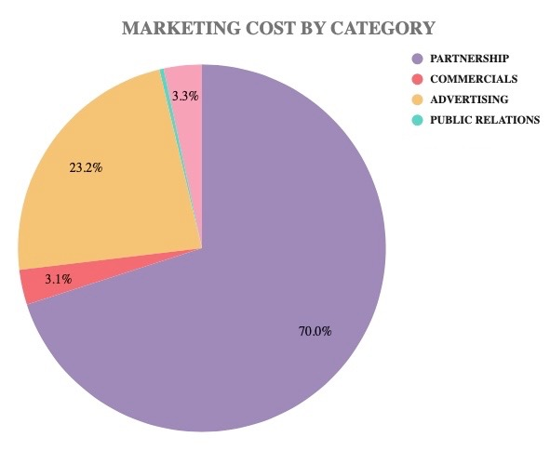
$13 MILLION
CAMPAIGN BUDGET

Slide 15
Marketing & Advertising
Traditional advertising
In-store
Commercials
Posters
Social Media
#thehappiestrideonearth
Platforms

Slide 16
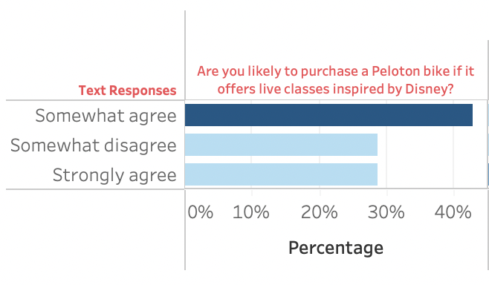
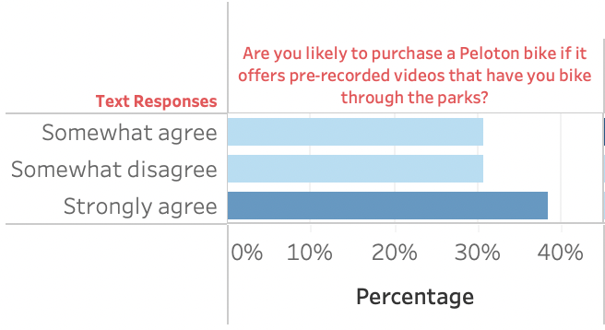
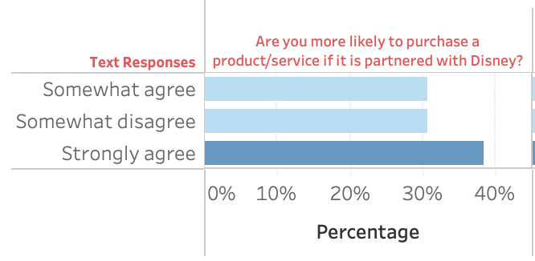
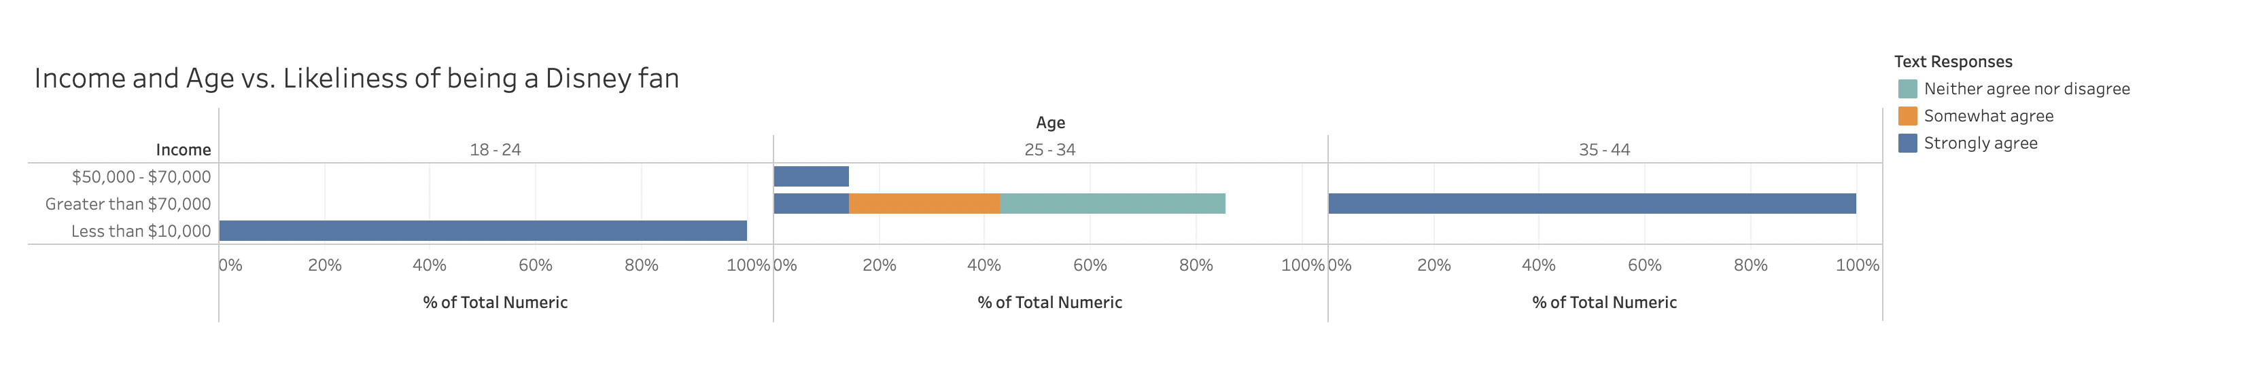
SUMMARY OF QUALTRICS SURVEY

Slide 17
INTERVIEW AND RESEARCH SUMMARY
"Customers are more attracted to the monitor at first glance"
Brianna
Peloton branch manager
50% of Disney + viewers are adults with no kids
37% of Peloton users are between 35-44
48 live classes per day
2 million songs in the Peloton library
78% retention rate for Disney+

Slide 18
03
CONCLUSION

Slide 19
In Conclusion...
“The Happiest Ride on Earth”
will generate revenue & attract Millennials to make an immediately purchase to tune into the exclusive Disney features
The consumer can relive, and heighten, the extraordinary memories of the Disney experience in the convenience of their own home.

Slide 20
THANKS!
DO YOU HAVE ANY QUESTIONS?

Slide 21
WORKS CITED
- Tedder, Michael. “Disney+ Has a Plan to Target Adults (Not Just Families).” TheStreet, TheStreet, 16 May 2022, https://www.thestreet.com/investing/disney-has-a-plan-to-target-adults-not-just-families.
- Wcs. “Top 10 Peloton Competitors in 2022.” What Competitors, 20 Jan. 2022, https://whatcompetitors.com/peloton/.
- “Disney+ Subscriber Statistics 2022: How Many People Watch Disney+?” Backlinko, 20 Mar. 2021, https://backlinko.com/disney-users#disney-subscriber-retention-rate.
- Smith, Craig. “Interesting Peloton Statistics and Facts.” DMR, 2 Aug. 2022,
https://expandedramblings.com/index.php/peloton-statistics-and-facts/.
“Peloton Revenue and Usage Statistics (2022).” Business of Apps, 4 May 2022,
https://www.businessofapps.com/data/peloton-statistics/.
- “Disney+ Subscriber Statistics 2022: How Many People Watch Disney+?” Backlinko, 20
Mar. 2021, https://backlinko.com/disney-users#disney-subscriber-retention-rate.
- Bussey, Hannah. “Is Apple about to Buy Peloton?” Cyclingweekly.com, Cycling Weekly, 22 June 2022, https://www.cyclingweekly.com/products/is-apple-about-to-buy-peloton.

